Slide 1

Project Climate Enthusiasts
UC Berkeley Extension
Data Analytics Bootcamp
Class of 2023
Contributors: Nour Balhaj (@nourbalhaj)
Hany Dief (@hanydief)
Beethoven Sabar (@bsabar)
Alejandro Gutierrez (@alejfxguti)
Raymond Darrough (@raymonddarrough)
JP Fortunato (@joaopedrofortunato)

Slide 2
Introduction: Overall objectives
Climate change is a critical issue facing our planet, and understanding climate data is essential for monitoring and analyzing its impact. In this project, we explore a Flask web application that connects to a PostgreSQL database containing climate data. The application provides interactive visualizations to help us gain insights into temperature, CO2 emissions, humidity, and sea level rise.

Slide 3
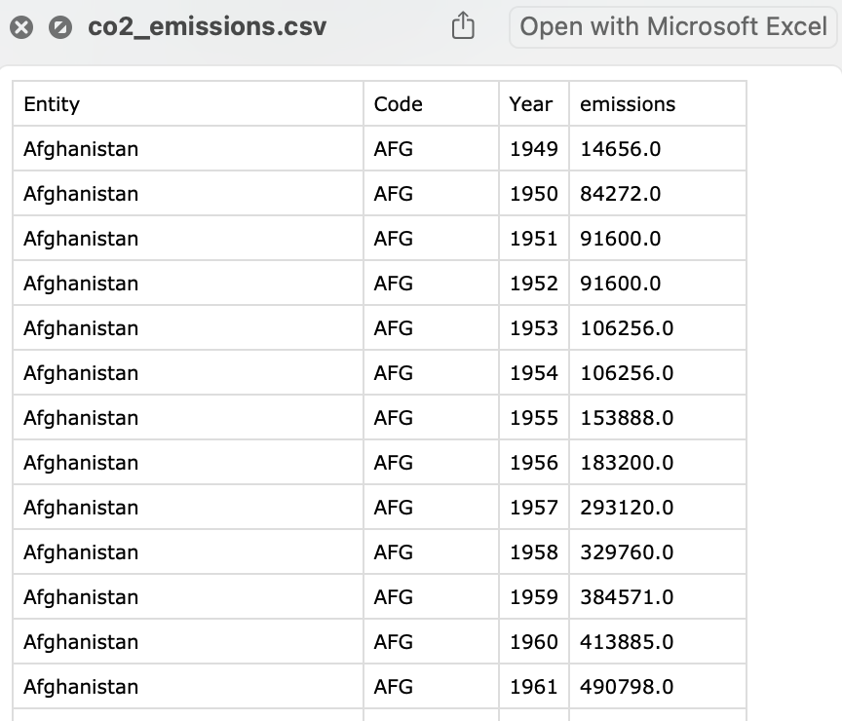
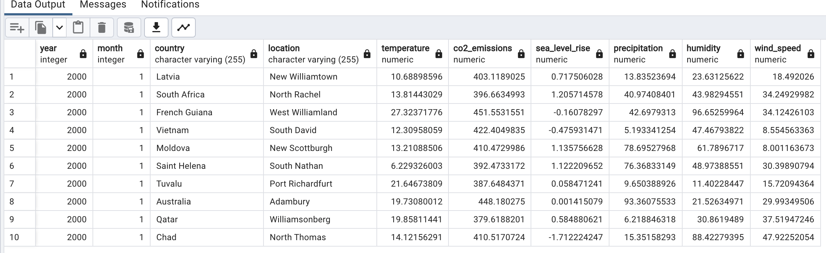
Data sources and Database: Source 1: https://www.kaggle.com/datasets/goyaladi/climate-insights-dataset Source 2: https://ourworldindata.org/co2-and-greenhouse-gas-emissions

Slide 4
Flask Routes / API Endpoints
The application provides the following routes to retrieve and visualize climate data. The data is grouped by country:
/: Displays the climate data home page.
/temp: Returns the average temperature data. The data is sorted in descending order of temperature and limited to the top 10 entries.
/co2: Returns the average CO2 emissions data. The data is sorted in descending order of CO2 emissions and limited to the top 10 entries.
/humidity: Returns the average humidity data. The data is sorted in descending order of humidity and limited to the top 10 entries.
/sealevel: Returns the average sea level rise data. The data is sorted in descending order of sea level rise and limited to the top 10 entries.
/temperatures: Returns the average temperature data for specific countries ('Finland', 'France', 'Germany', 'Iceland', 'Norway', 'Poland', 'Russia', 'United Kingdom') over the years.
/racebarco: Returns the average CO2 emissions data for each year and country.
/pltmapco: Returns the average CO2 emissions data for each country.

Slide 5
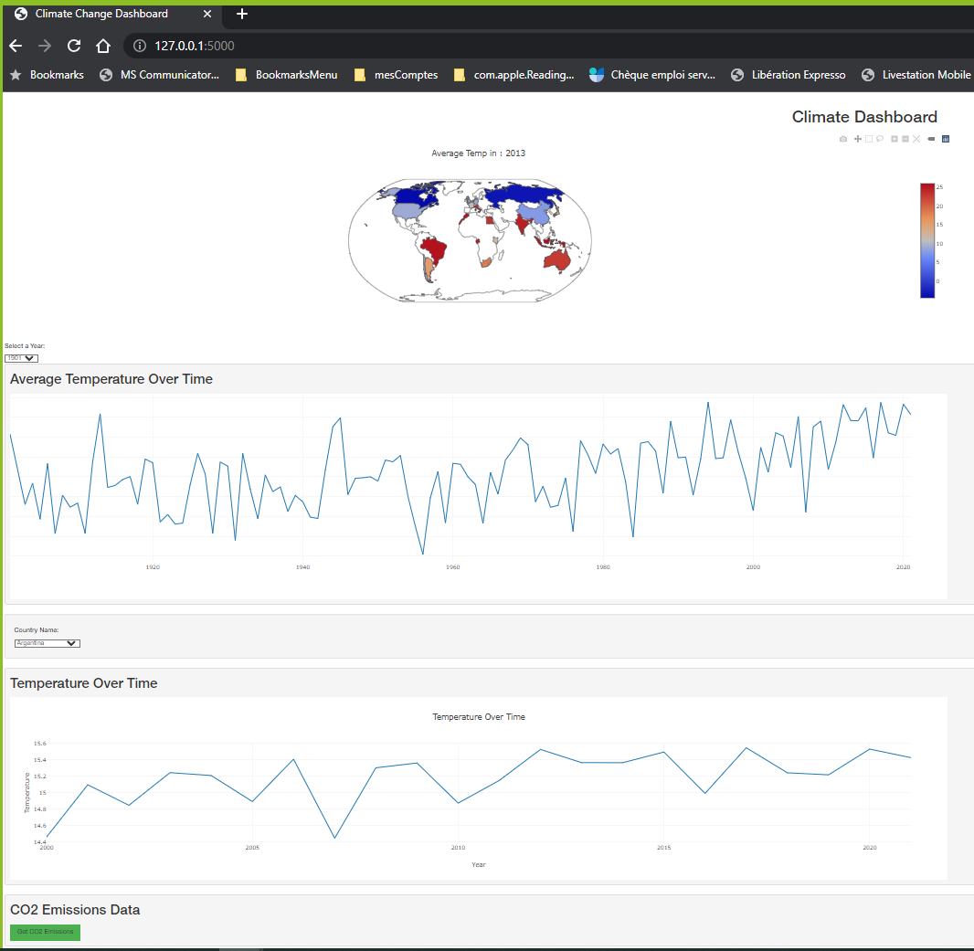
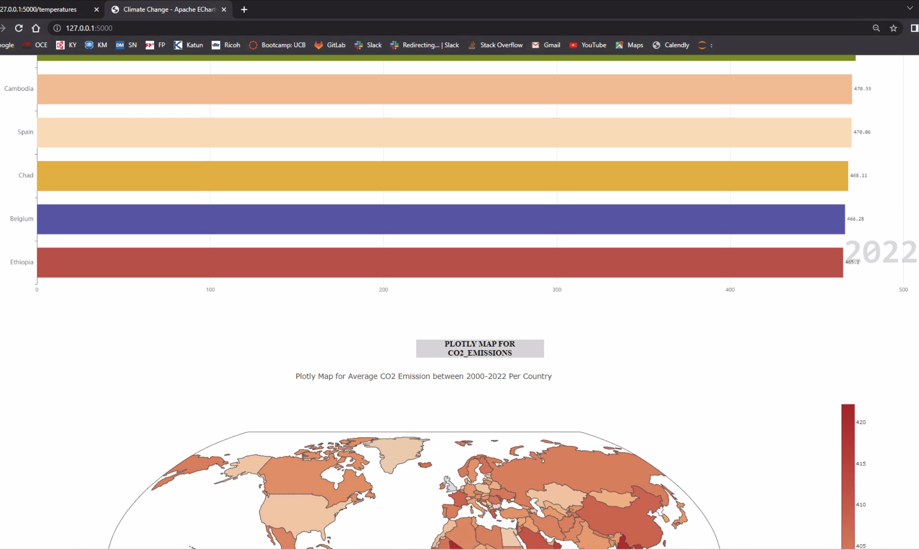
Front-end: HTML, CSS and JS

Slide 6
Demo Session
Q&A
Q&A

Slide 7
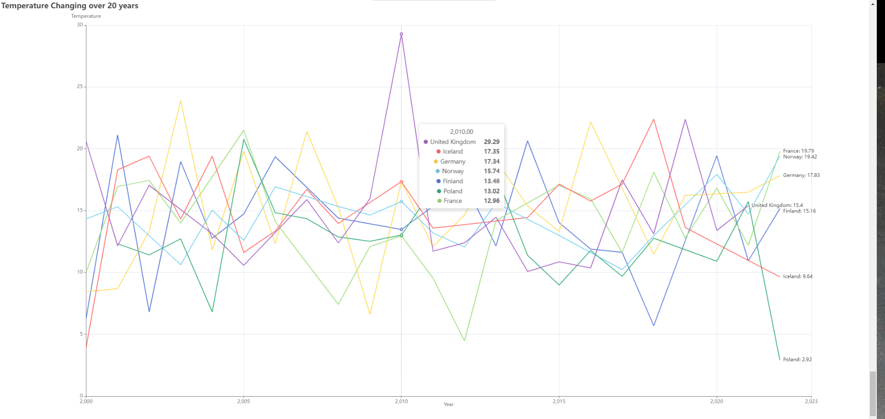
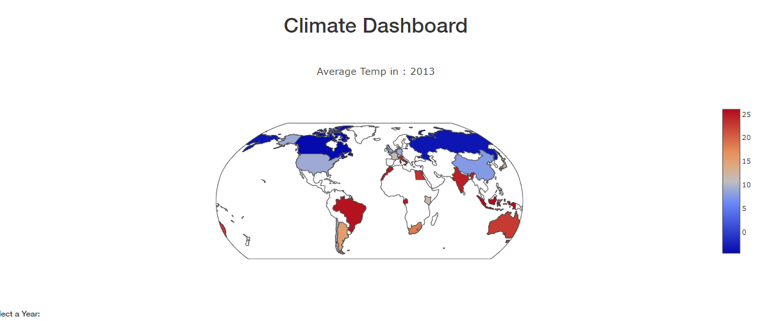
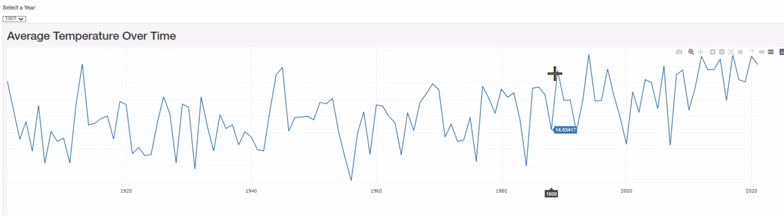
Temperature Analysis
One of the key aspects of climate change is rising temperatures. The web application presents a bar chart that shows the average temperature for each country and year. By selecting different years, we can observe how temperatures have changed over time. The chart reveals interesting trends and allows us to compare temperature variations among different countries.

Slide 8
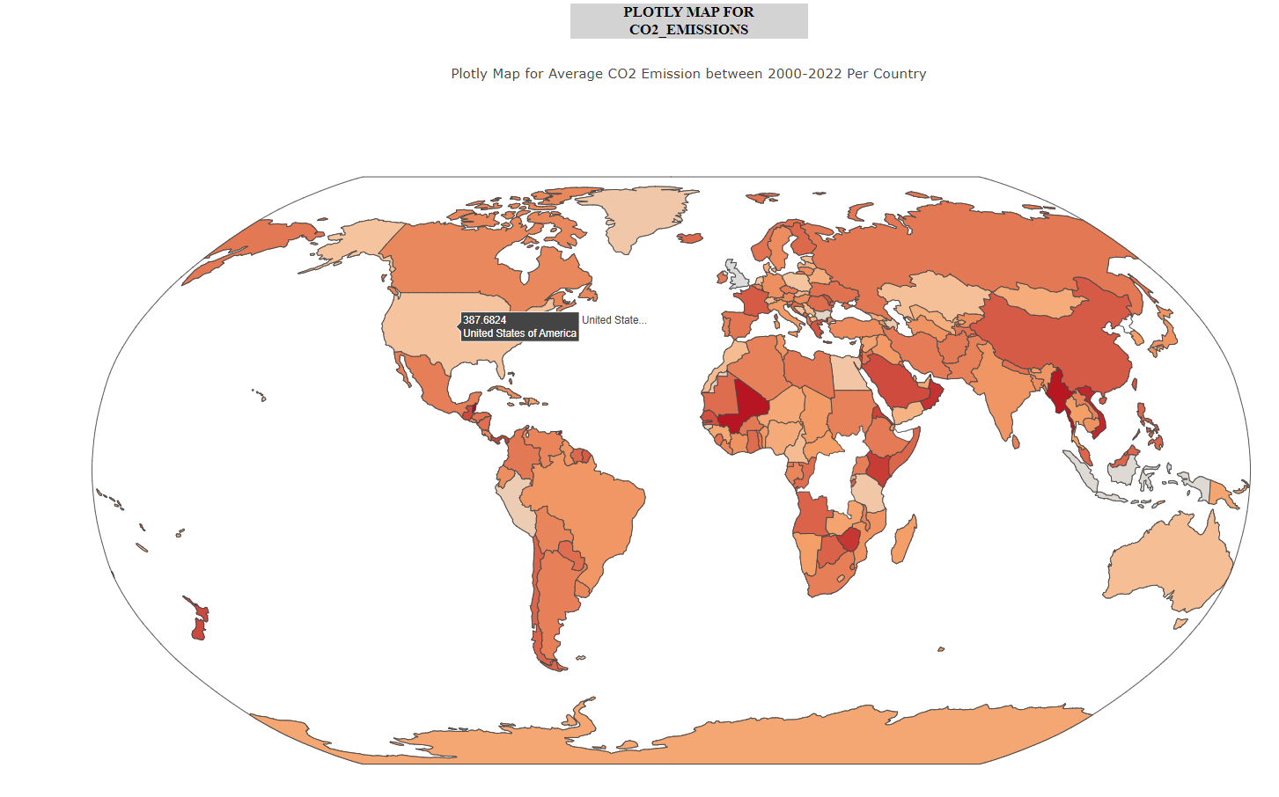
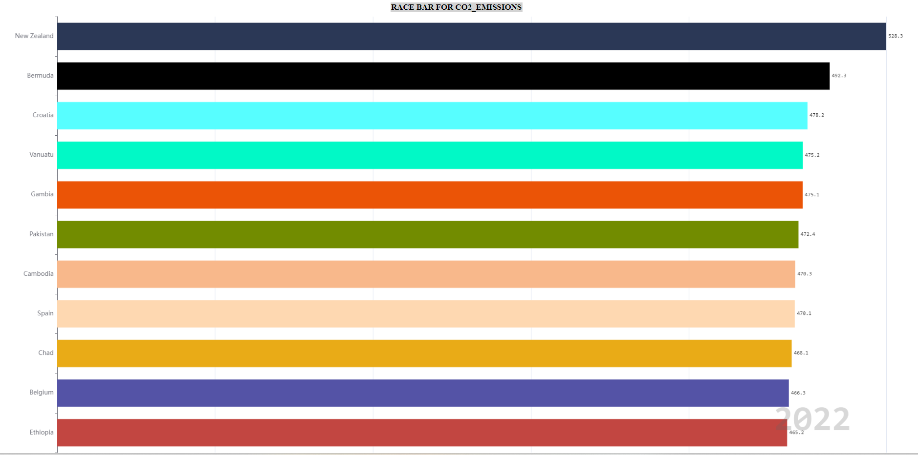
CO2 Emissions Analysis
CO2 emissions are a major contributor to global warming. The application provides another bar chart that displays the average CO2 emissions for each country and year. By exploring this chart, we can identify countries with higher emissions and track changes in their emissions over time. This visualization helps raise awareness of the environmental impact and provides insights for policymakers and researchers.

Slide 9
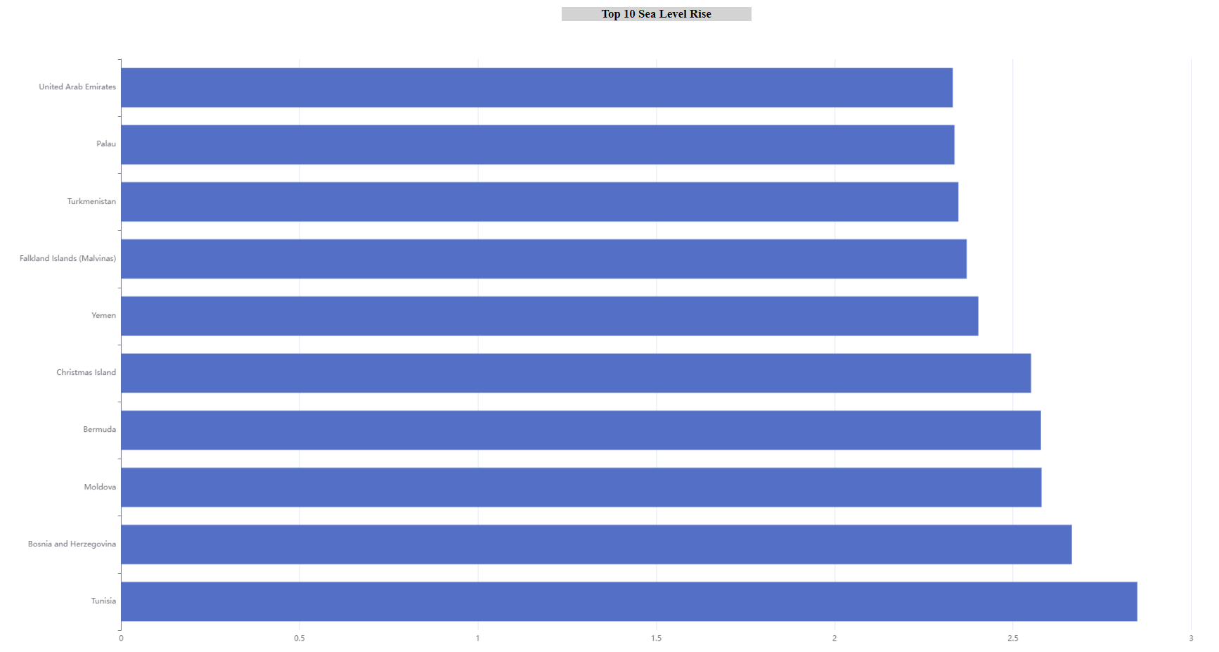
Sea Level Rise Analysis
Sea level rise is another consequence of climate change that poses significant threats to coastal areas. The web application showcases a bar chart that displays the average sea level rise for each country and year. By exploring this chart, we can identify countries experiencing more pronounced sea level rise and track changes in sea levels over time. This visualization helps raise awareness of the potential consequences of climate change on coastal regions.

Slide 10
Conclusion
The Flask web application and its visualizations provide valuable insights into climate data. By analyzing temperature, CO2 emissions, humidity, and sea level rise, we can understand the trends and patterns associated with climate change. These visualizations can support decision-making processes, raise awareness, and contribute to ongoing efforts to mitigate and adapt to climate change.

Slide 11
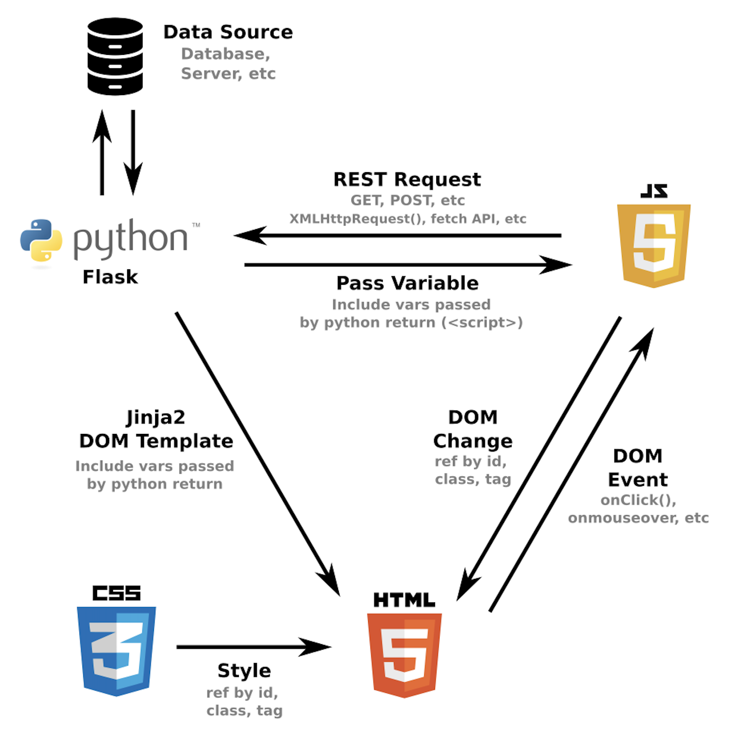
Challenges
Next Steps
Finding the right data.
Clarification on the workflow.
Defining team members scopes.
Merging flasks together (online and offline).
Plot visualizations for Temperature vs CO2 emissions and Sea Level Rise Analysis.
Adding more interaction filters in the plots.
Use the real data in the Race Chart.

Slide 12
Q&A
THANK YOU FOR YOUR ATTENTION!
Q&A
Q&A

